Slide 1
ENGR 11: Introduction to
Engineering Analysis I
GS 138
Dr. Mandala

Slide 2
Today
Pivot tables
Built-in math functions
Data transformation
Trend lines

Slide 3
Pivot Tables
An excel program tool that allows you to reorganize and summarize data in a spreadsheet to obtain a desired report.
A pivot table doesn't actually change the spreadsheet or database itself.
Refer Section 1.3.9 PIVOT TABLES from text-book.

Slide 4
Built-in Math Functions
built-in math functions
SIN(number) COS(number) | Returns the sine/cosine of the given angle. number is the angle in radians. If your argument is in degrees, multiply the number by PI()/180 or use the RADIANS function to convert it to radians
PI() | Returns the number 3.141592…, the mathematical constant 𝛑
EXP(number) | Returns e raised to the power of the number. The constant e equals 2.7182818, the base of the natural logarithm

Slide 5






What are Logarithms
exponent
The exponent tells us how many times to use the base in a multiplication
base
A logarithm answers the following question:
Therefore, the logarithm tells us what the exponent is:
General form
base 10
base e

Slide 6
Built-In Functions
built-in math functions
LOG(number, base) | Returns the logarithm of a number to the base you specify. If base is omitted, it is assumed to be 10
LOG10(number) | Returns the base-10 logarithm of a number
LN(number) | Returns the natural logarithm of a number. Natural logarithms are based on the constant e

Slide 7
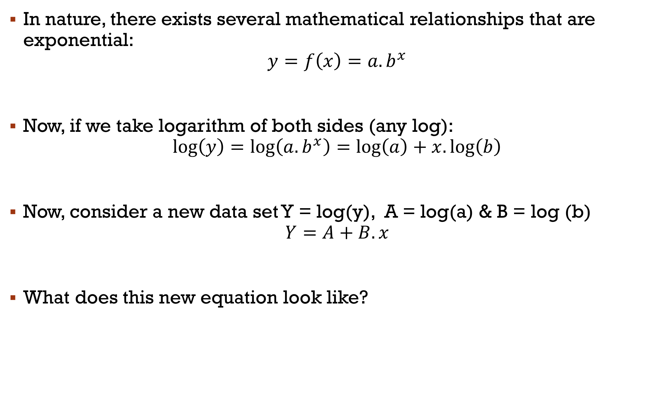
Data Transformation
In nature, there exists several mathematical relationships that are exponential:
$$y=f\left(x\right)=a.b^{x}$$
Now, if we take logarithm of both sides (any log):
$$\log\left(y\right)=\log\left(a.b^{x}\right)=\log\left(a\right)+x.\log\left(b\right)$$
Now, consider a new data set Y = log(y), A = log(a) & B = log (b)
$$Y=A+B.x$$
What does this new equation look like?

Slide 8

Semi-log Transformation
The transformation of data from:
$$y vs x$$
to
$$Y=\log\left(y\right) vs x$$
is called semi-log transformation
We take logarithm of data in the output column ($y or f(x)$) and not the input column ($x$)

Slide 9
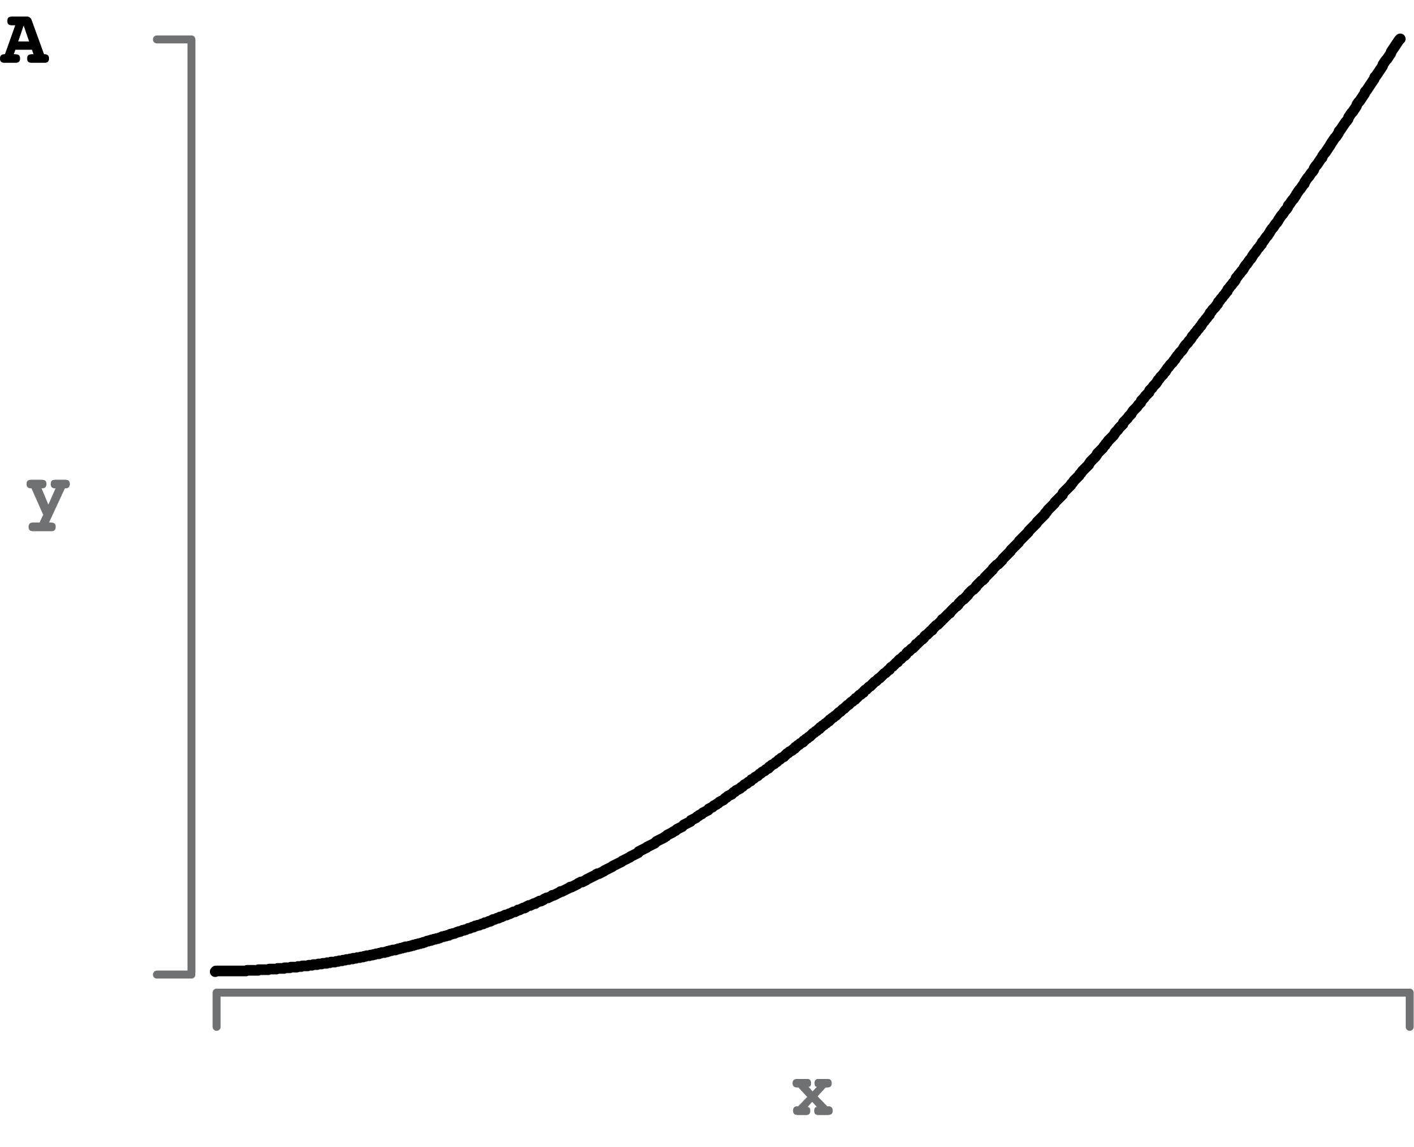
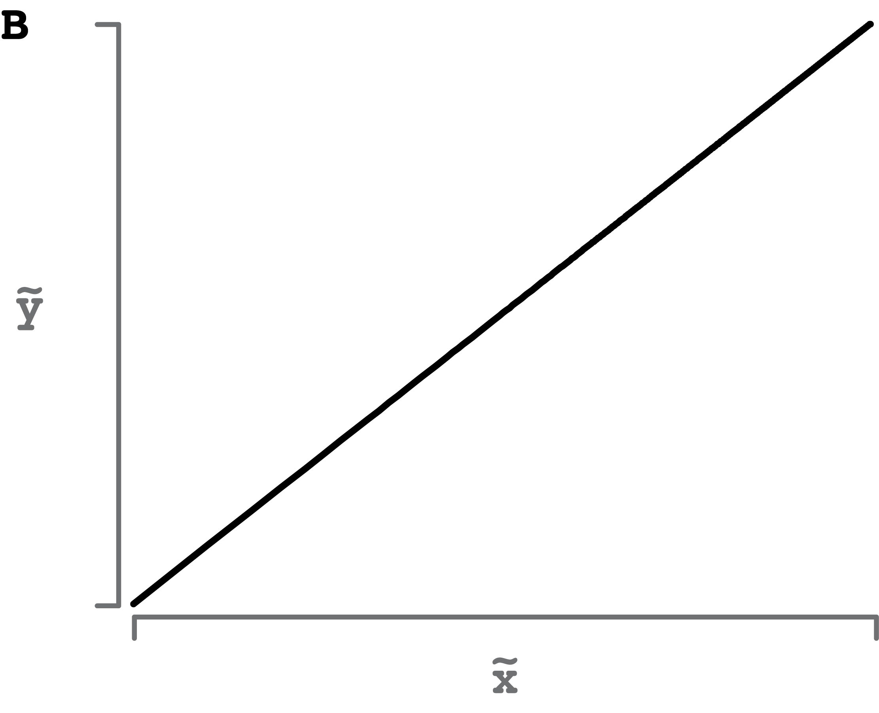
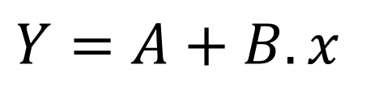
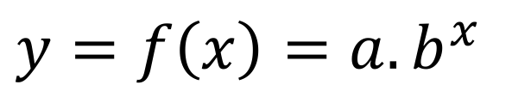
Graphically…
$$y=f\left(x\right)=a.b^{x}$$
$$Y=A+B.x$$

Slide 10
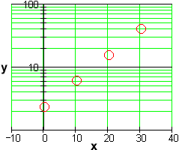
EXTRA: Manually Plotting in Semi-log

Slide 11
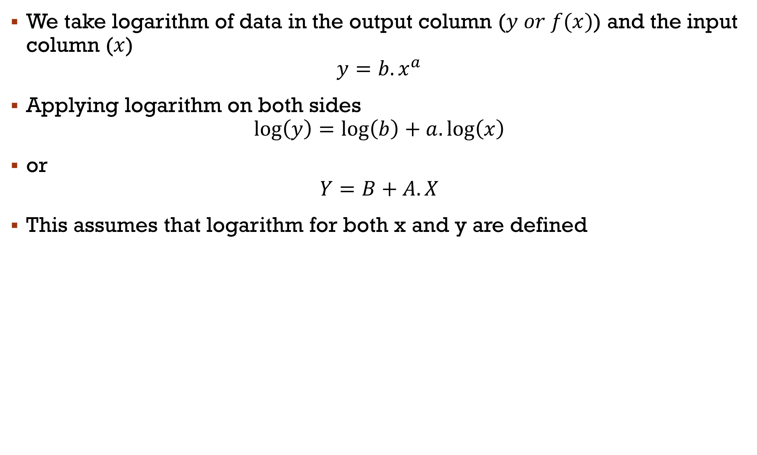
Log-Log transformation
We take logarithm of data in the output column ($y or f(x)$) and the input column ($x$)
$$y=b{.x}^{a}$$
Applying logarithm on both sides
$$\log\left(y\right)=\log\left(b\right)+a.\log\left(x\right)$$
or
$$Y=B+A.X$$
This assumes that logarithm for both x and y are defined
Notes:
If x is positive and not 1, no power of x results in a value of 0.

Slide 12
TrendLines
As an engineer you may have to solve problems where relationship between variables is not well defined.
Collect data
Find relationship between variables and define equation
Predict present or future conditions
Jon wants to predict amount of lemonade to make for sale in summer weeks, he knows the weather information for summer.
Collected data from last year: temperature and revenue

Slide 13
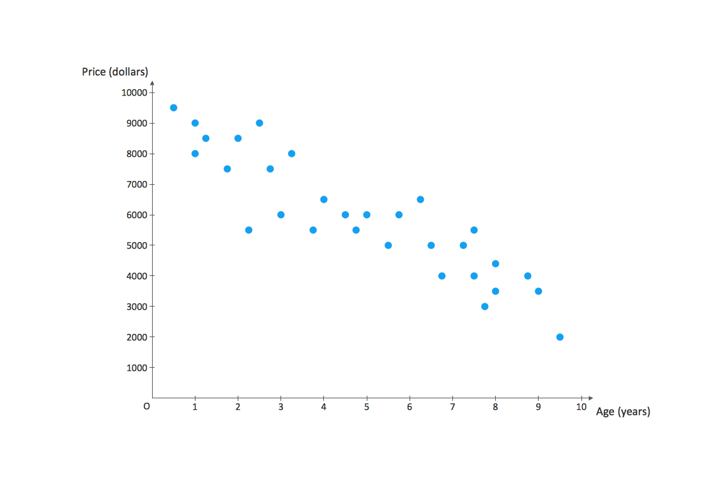
How did excel fit a straight line?
Least-square analysis: minimize the sum of squares of the differences between original data and those obtained from the fitted line.

Slide 14
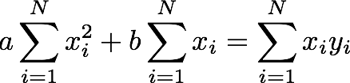
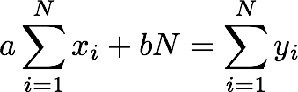

Linear regression steps
Solve two simultaneous equations to find values of a & b:
Best fit curve: $y=ax+b$

Slide 15
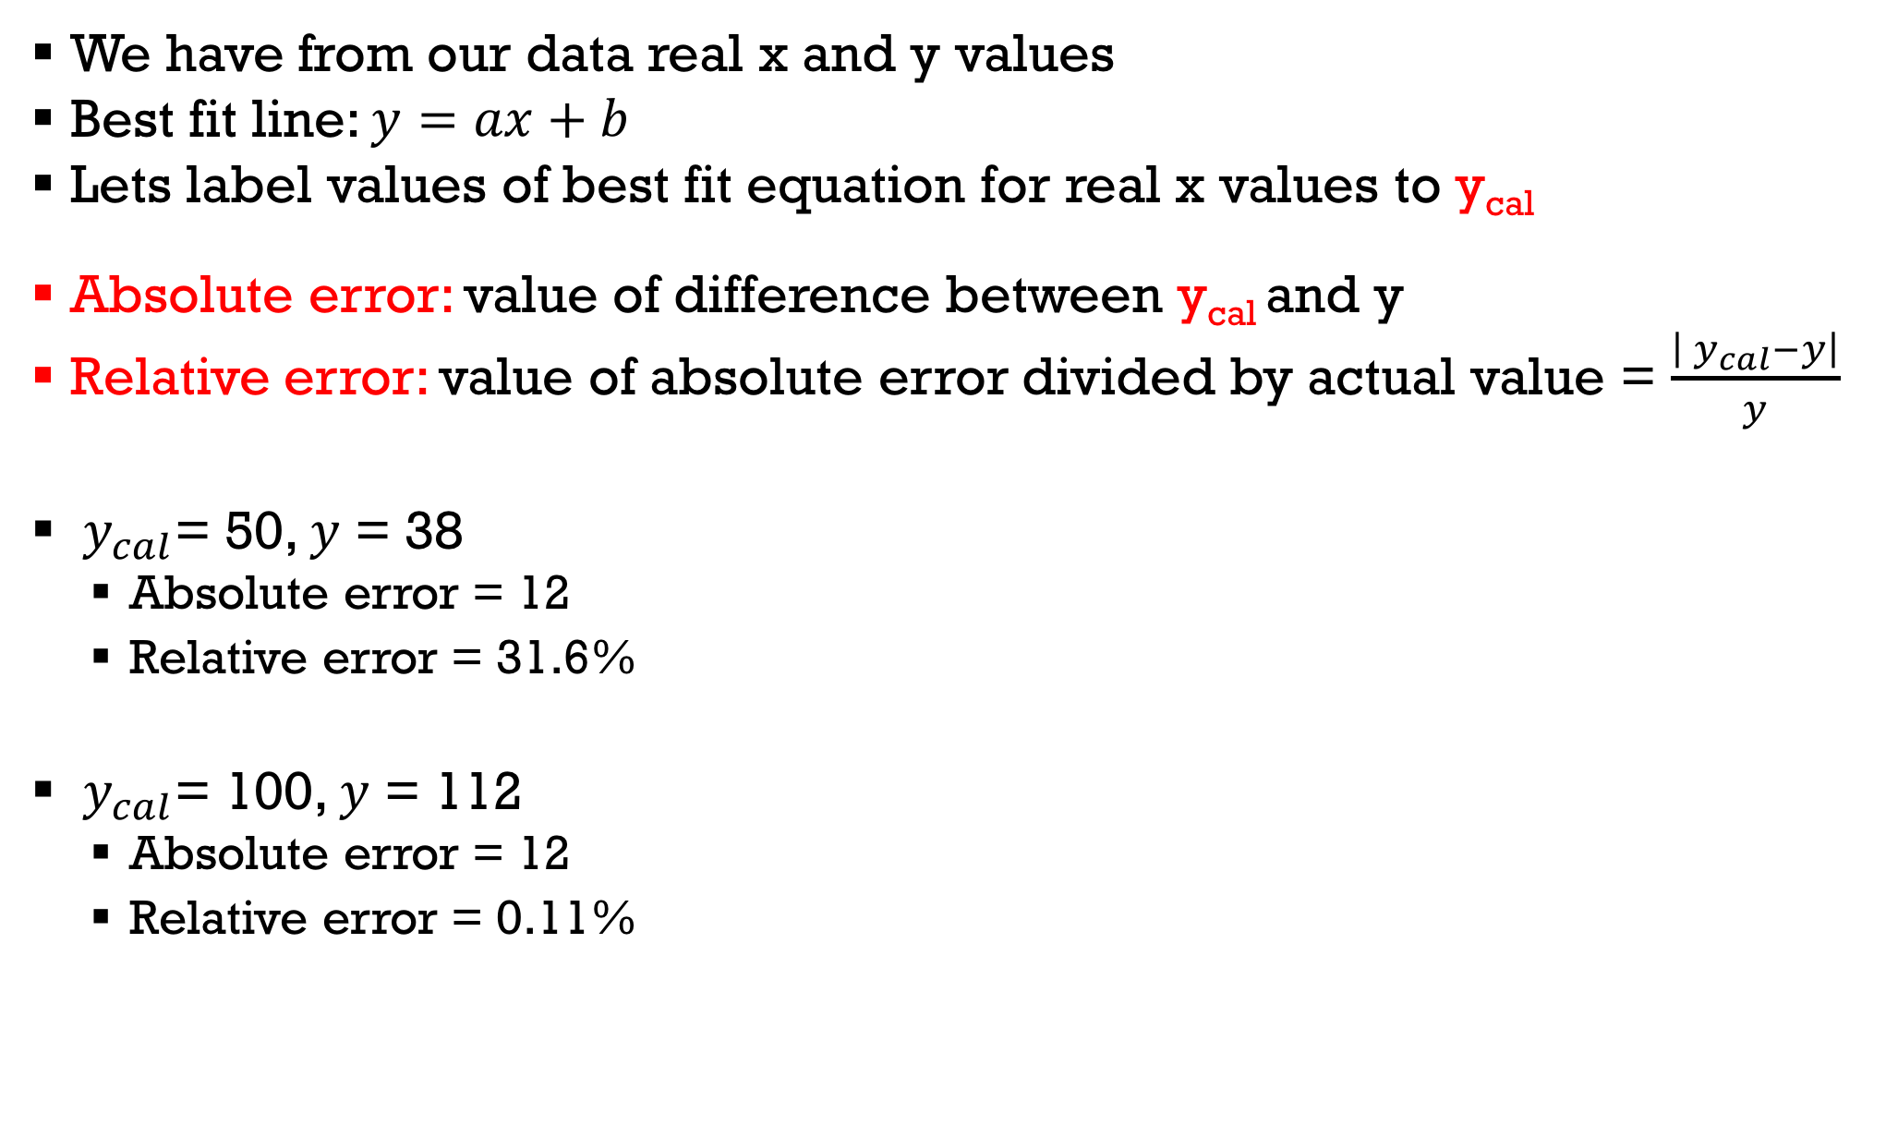
Error Analysis
We have from our data real x and y values
Best fit line: $y=ax+b$
Lets label values of best fit equation for real x values to y_{cal}
Absolute error: value of difference between y_{cal} and y
Relative error: value of absolute error divided by actual value = $\frac{\left|{ y}_{cal}−y\right|}{y}$
${ y}_{cal}$= 50, $y$ = 38
Absolute error = 12
Relative error = 31.6%
${ y}_{cal}$= 100, $y$ = 112
Absolute error = 12
Relative error = 0.11%

Slide 16

r-squared values
$$r^{2}=1−\frac{SSE}{SST}$$
SSE: Sum of square of absolute errors
$$SSE=\sum_{i=1}^{n}{{\left(y_{i}−f\left(x_{i}\right)\right)}^{2}}$$
SST: Sum of the square of total deviations about the mean $(y−mean(y))$
$$SST=\sum_{i=1}^{n}{{(y_{i}−\overline{y})}^{2}}$$

Slide 17
acknowledgment
Based on work by Prof. Arash Mahboobin

